Slide 1




SoK: Critical Evaluation of Quantum Machine Learning for Adversarial Robustness
Saeefa Rubaiyet Nowmi∗ , Jesus Lopez∗ , Md Mahmudul Alam Imon† , Shahrooz Pouryousef‡, Mohammad Saidur Rahman∗
∗University of Texas at El Paso, †University of Dhaka, ‡University of Massachusetts Amherst
IEEE Symposium on Security and Privacy (S&P) 2026
May 18, 2026 | San Francisco, CA
Notes:
#Slide 1: 30 sec
--------------------------
Good Morning everyone.
I am Saeefa Rubaiyet Nowmi, PhD student from University of Texas at El Paso.
Today, I’ll be presenting our paper on Adversarial Robustness of Quantum Machine Learning.

Slide 2
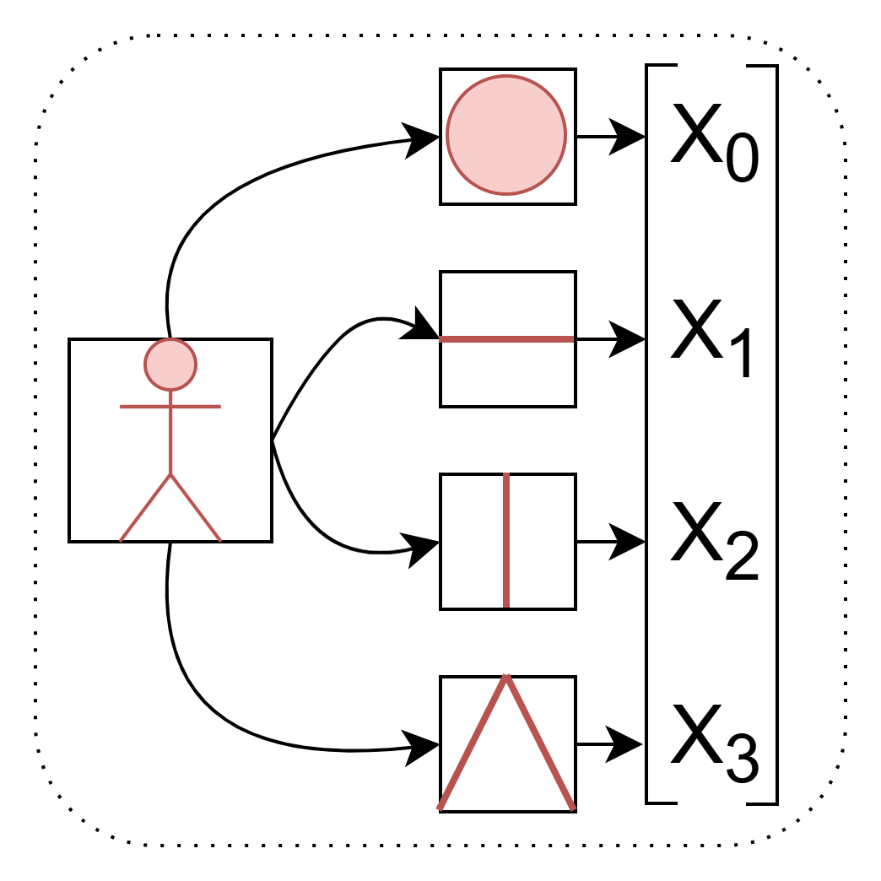
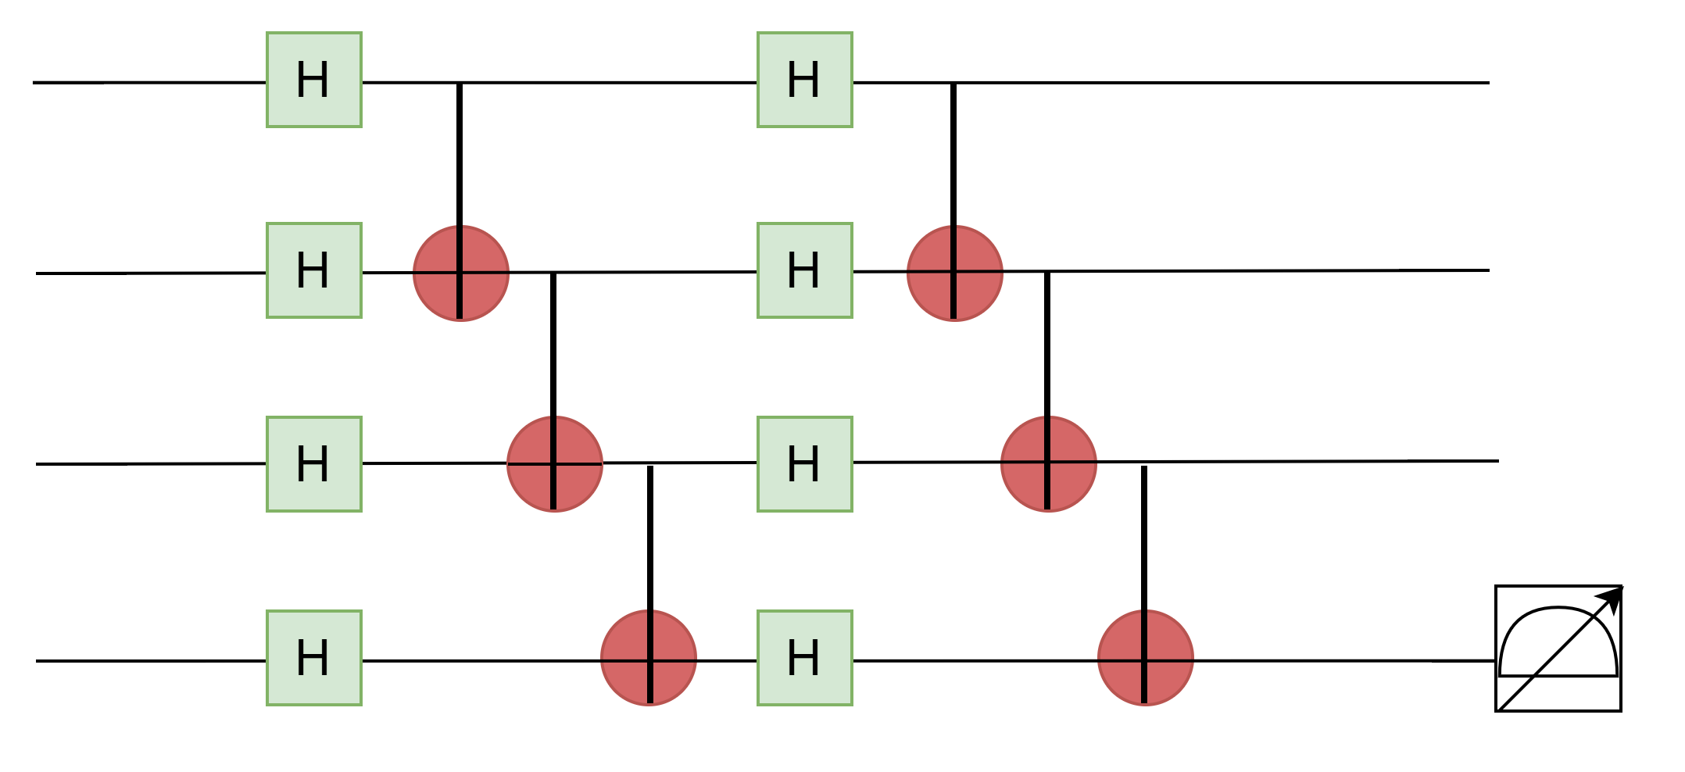
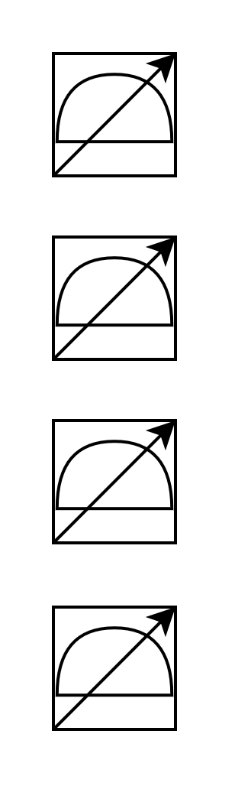


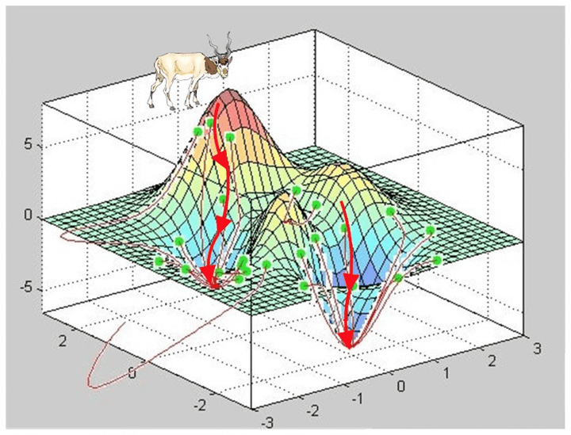
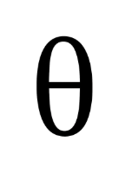
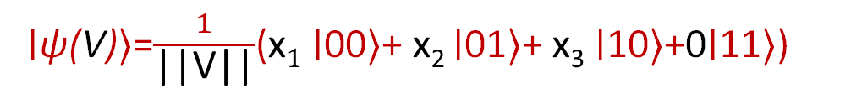
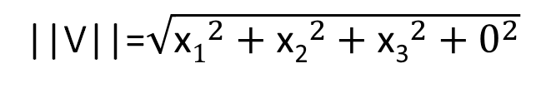
Hybrid Quantum Classical Machine Learning Model
Qubits
Classical Optimizer
Classical Data
Encoding
U
Measurements
Parameterized Quantum
Circuit (PQC)
Angle Encoding
Amplitude Encoding
α₁
α₃
V_{pad}= [x₁, x₂, x₃, 0]
V = [x₁, x₂, x₃]
Q₀: R_{y}(θ₁) |0>
Q₁: R_{y}(θ₂) |0>
Q₂: R_{y}(θ₃) |0>
y
α₂
α₄
Normalize
[ norm 1]
Normalize
[0 – π]
θ
2^{n} Amplitudes
x
||V||=$\sqrt{{\text{x}1}^{2}+{\text{x}\text{2}}^{2}+{\text{x}\text{3}}^{2}+0^{2}}$
[θ₁, θ₂, θ₃]
z
∣ψ(V)⟩=$\frac{1}{\text{||}\text{V}\text{||}}$​($\text{x}1$∣00⟩+ $\text{x}\text{2}$∣01⟩+ $\text{x}\text{3}$∣10⟩+0∣11⟩)
Notes:
#Slide 2: 2 min
------------------------------
Before discussing robustness, let me briefly explain how a hybrid QML model works.
First, we take classical data and then we take qubits. Then we use some encoding technique to encode the classical data into qubits. Then the encoded quantum states get processed through parameterized quantum circuit or (PQC) which can be compared to neural networks. Then we measure the quantum states and it collapse to classical outputs. We send the classical outputs to classical optimizer for training. The optimizer send the updated parameter values to the PQC and the cycle repeats till the final measurement.
For our work, we experimented with two most commonly used encoding methods.
First one is angle encoding, where features are mapped to rotation angles.
Suppose, we take this classical 3- dimensional vector V.
Then normalize the data between 0 to pi.
Then use these normalized values as rotation angles for each qubit. So, to encode 3 values, we need 3 qubits.
The second method is amplitude encoding, where normalized feature values are embedded directly into the amplitudes of a quantum state.
An $N$-qubit system can represent $2^{N}$amplitudes. So, to encode 3 values, we need at least 2 qubits, and we pad the remaining amplitude with zero.
Then we normalize the vector so that its norm becomes 1, and this produces the final amplitude-encoded quantum state.”
A key point is that the encoding strategy fundamentally impacts both the model capability and its security properties.

Slide 3
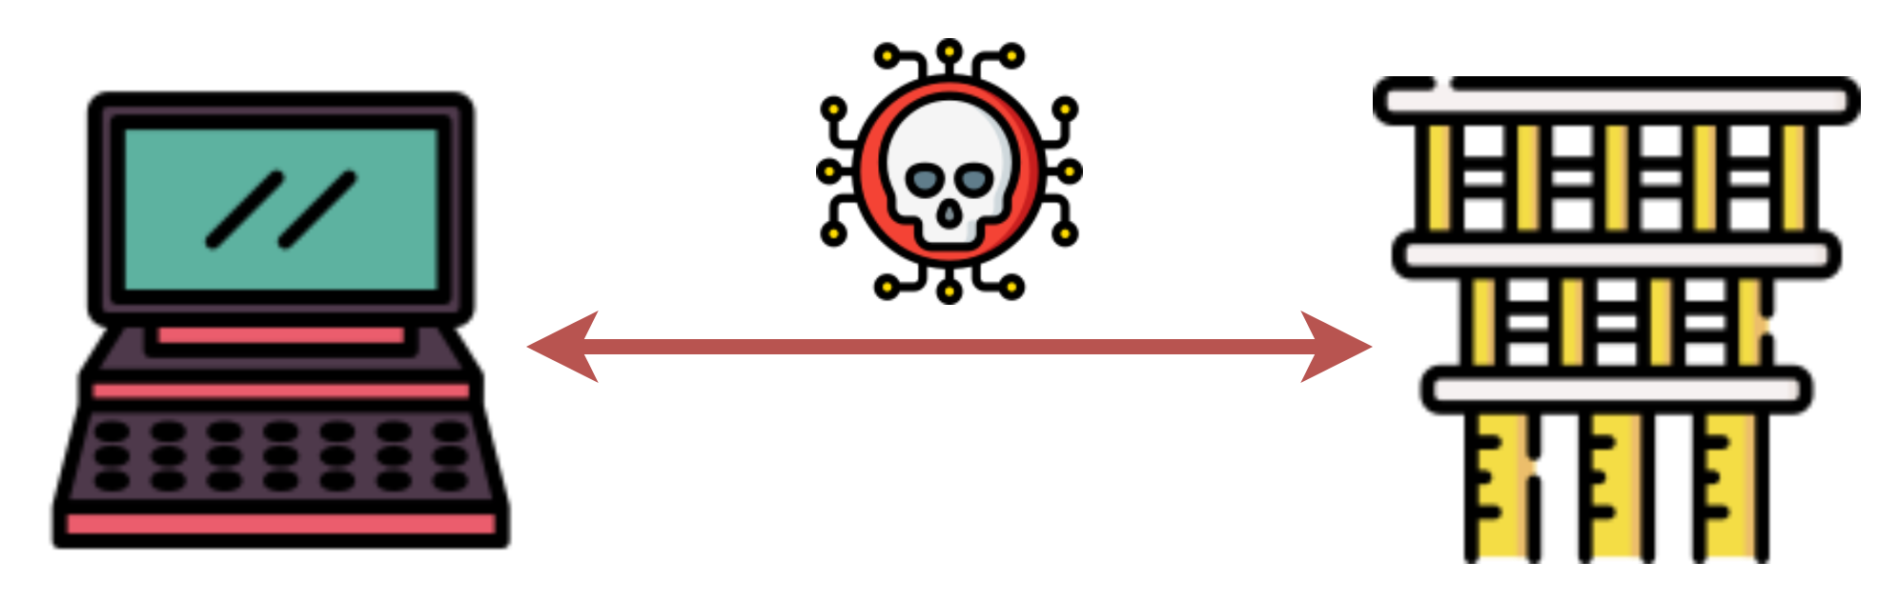




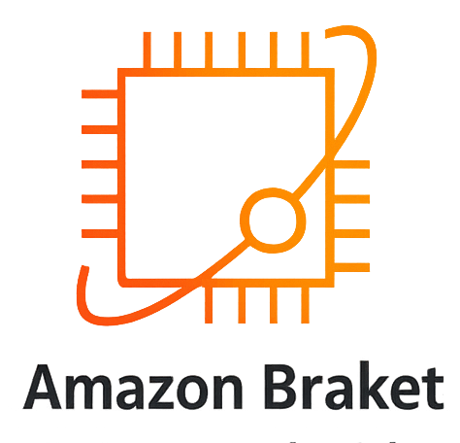

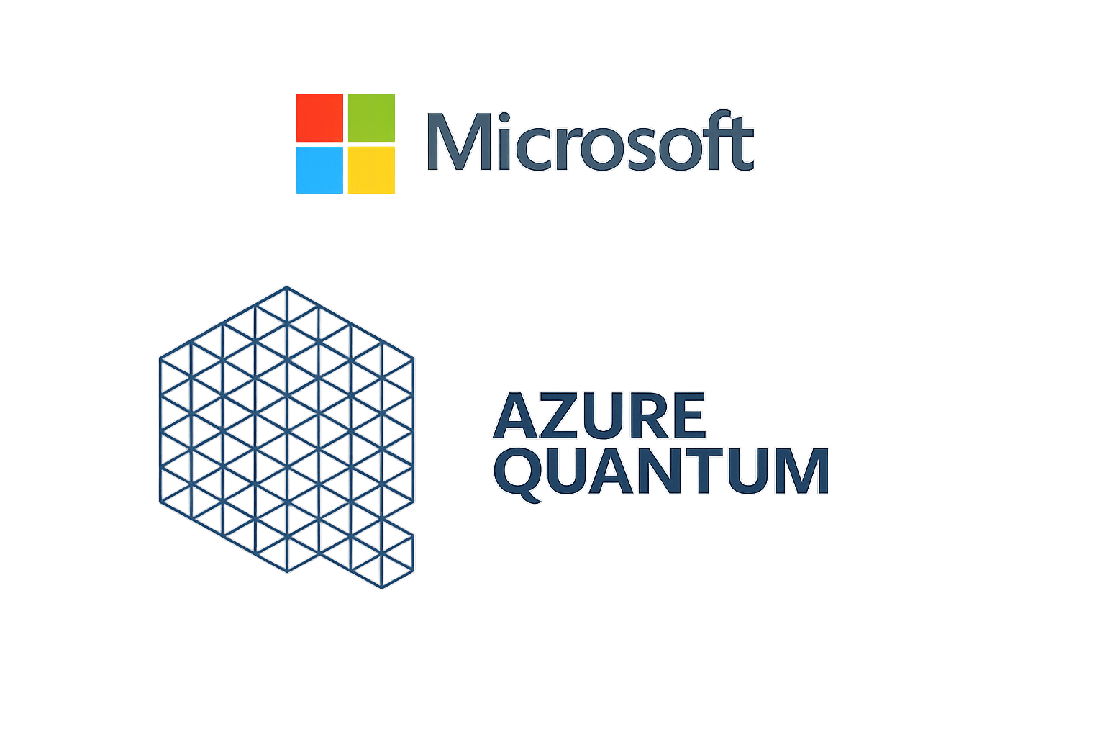


Sources of Vulnerability
Hybrid Attack Surface
Cloud Service for Quantum Hardware
y
θ
x
z
Encoding and Depth
Noisy Multi-tenant NISQ Device
Notes:
#Slide 3: 1 min
------------------------------
Now,
The QML systems introduce a unique hybrid attack surface. It inherits many traditional machine learning vulnerabilities such as poisoning, and backdoor attacks. And the quantum computing also introduces unique new risks.
Today’s quantum hardware is mostly accessed through cloud providers like IBM Quantum or Azure Quantum. That means users must deploy their models and data remotely, increasing exposure to cloud-based attacks.
Different encoding techniques and PQC depth introduces different vulnerabilities due to their unique fundamental properties.
Another issue is that current NISQ devices are noisy and multi-tenant. Attackers may exploit neighboring qubits or side channels to leak information.
So, our goal is to systematically analyze how encoding methods, circuit depth, and hardware noise affect adversarial robustness of QML systems.”

Slide 4




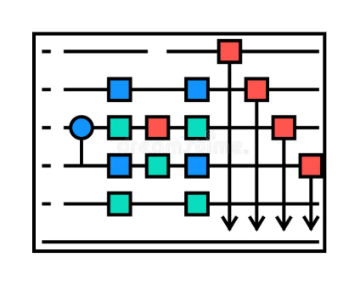


Taxonomy of Attacks
Pre-
processing
Post-
processing
Black-Box (B)
Model Extraction
Crosstalk-Induced
Side-Channel Attacks
3. Membership Inference
4. Data Poisoning
5. Backdoor Attacks
6. Adversarial Evasion
White-Box (W)
Backdoor Attacks
Hardware/ Compiler Trojan Attacks
Input Inference
Adversarial Evasion
Output
B(4,5)
B(2)
G(2)
B(6)
W(1,3)
B(1,3)
G(3)
W(2)
G(1)
W(3, 4)
Gray-Box (G)
Backdoor Attacks
Quantum Indiscriminate Data Poisoning (QUID)
Pulse level Attacks
Quantum Hardware
User
Notes:
#Slide 4: 50 sec
------------------------------
This slide presents the first major contribution of our paper — a taxonomy of attacks on Quantum Machine Learning systems.
We categorize attacks based on the attacker’s access level into black-box, gray-box, and white-box settings. This figure shows exactly where attacker need access in the QML pipeline to deploy each attack. Suppose, for Black-box Model extraction attack, the attacker needs to be able to query the model and access the out-put. So, the attacker needs access here.---- that’s B1. We also categorize the attacks according to whether they target the training phase or the inference phase.
This taxonomy helps us systematically understand where vulnerabilities exist in the QML pipeline, and whether classical defenses are sufficient or quantum-specific defenses are needed for particular vulnerabilities.

Slide 5
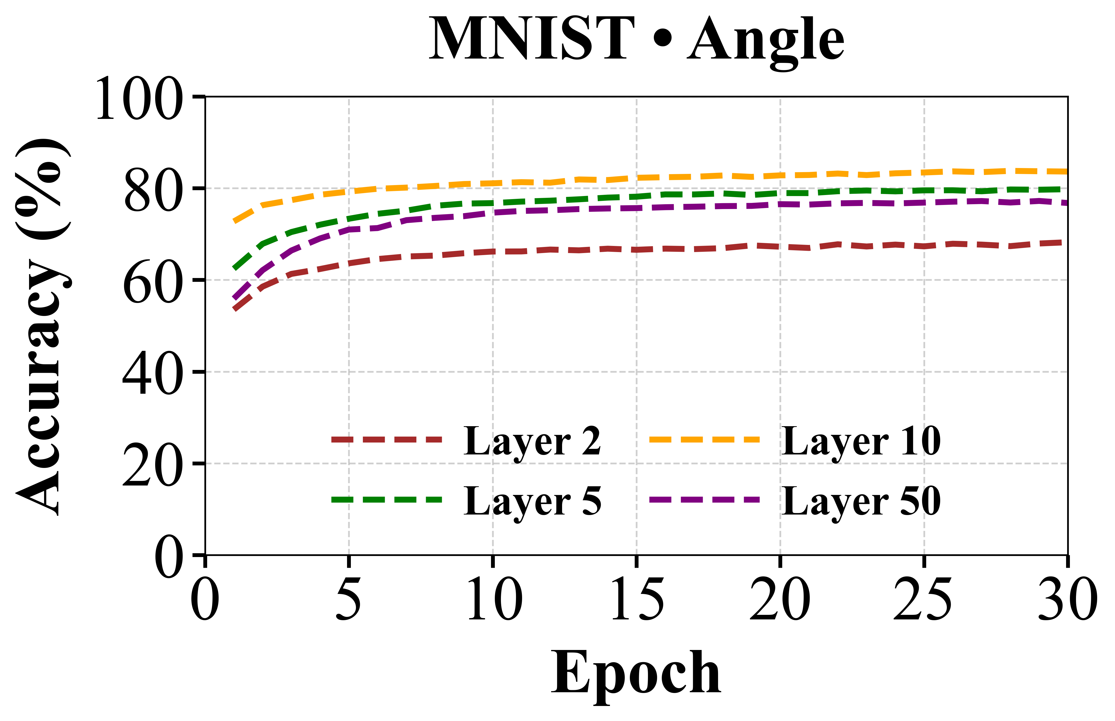
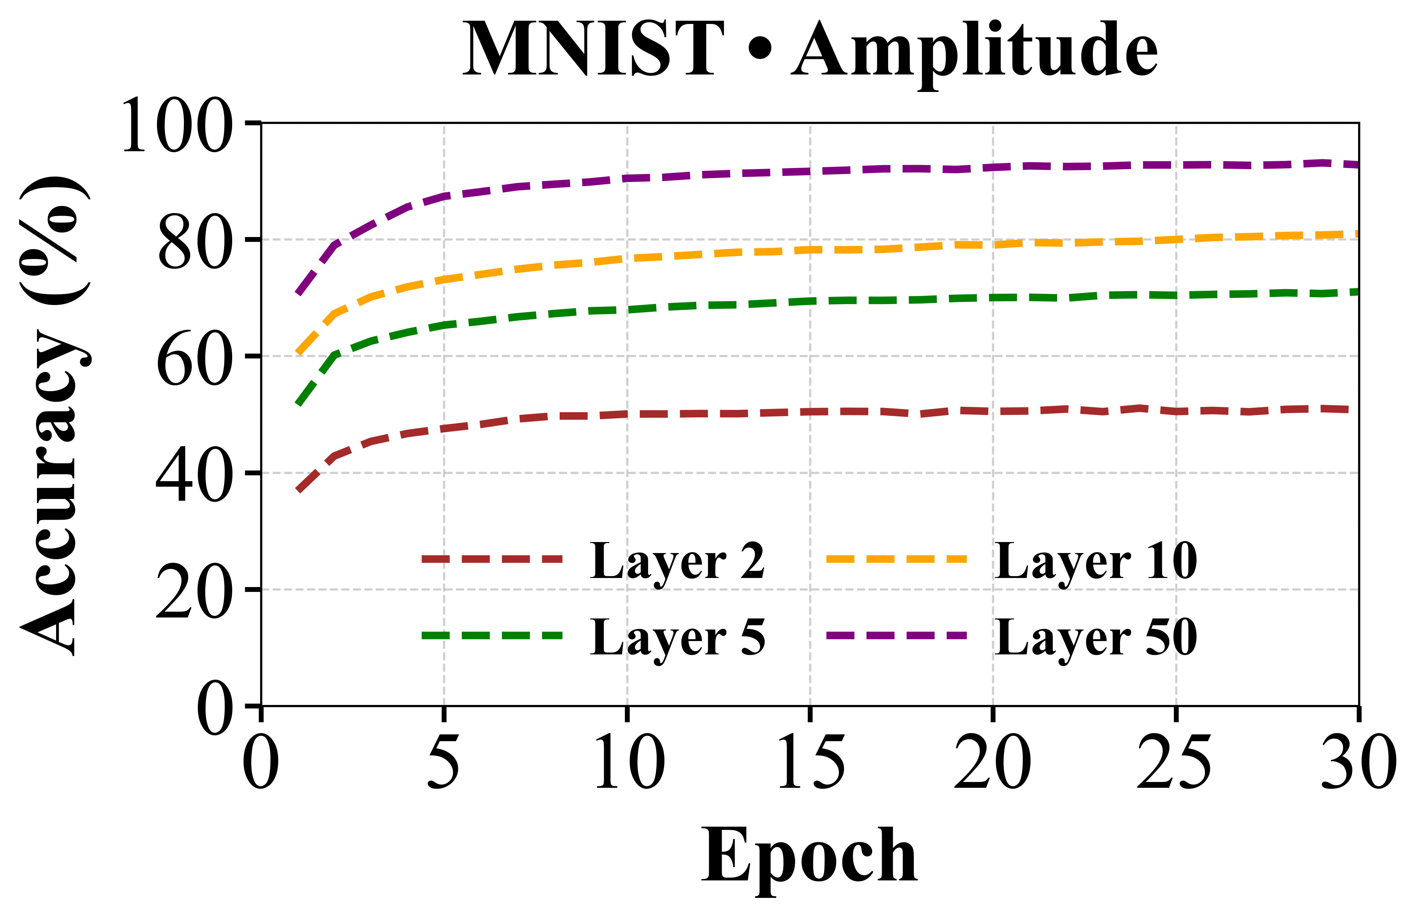
Experimental Setting and Baseline Models
PQC Depth
2, 5, 10, 50 layers
Encoding Schemes
Angle encoding
Amplitude Encoding
Performance decrease at Layer 50
Datasets
AZ-Class (AndroZoo Malware, 23 Classes)
MNIST (Image dataset -10 classes)
Key Insights
Encoding and circuit depth jointly determine QMLP performance
Angle encoding favors shallow circuits (highest accuracy gain for 10layer PQC)
Amplitude encoding benefits from deeper circuit.
Noise severely limits model accuracy, with shallow angle-encoded circuits showing relatively higher resilience.
Conditions
Noiseless Setting
Noisy Setting (Depolarized Noise, p=0.01)
Classical ML
Notes:
#Slide 5: 1 min 20 sec
------------------------------
After categorizing the attacks, we selected representative attacks from different categories to evaluate how QML models behave under adversarial settings.
We used PQCs with depths of 2, 5, 10, and 50 layers using both angle and amplitude encoding.
Experiments were conducted on two datasets from different domains: the AndroZoo malware dataset and the MNIST image dataset, under both noiseless and noisy environments.
One key observation is that amplitude-encoded models improve as circuit depth increases and can approach classical ML performance in noiseless settings.
However, for angle encoding, performance improves only up to a moderate depth and then starts decreasing for very deep circuits.
Under noisy conditions, all models degrade, but shallow angle-encoded models show relatively better resilience.”

Slide 6
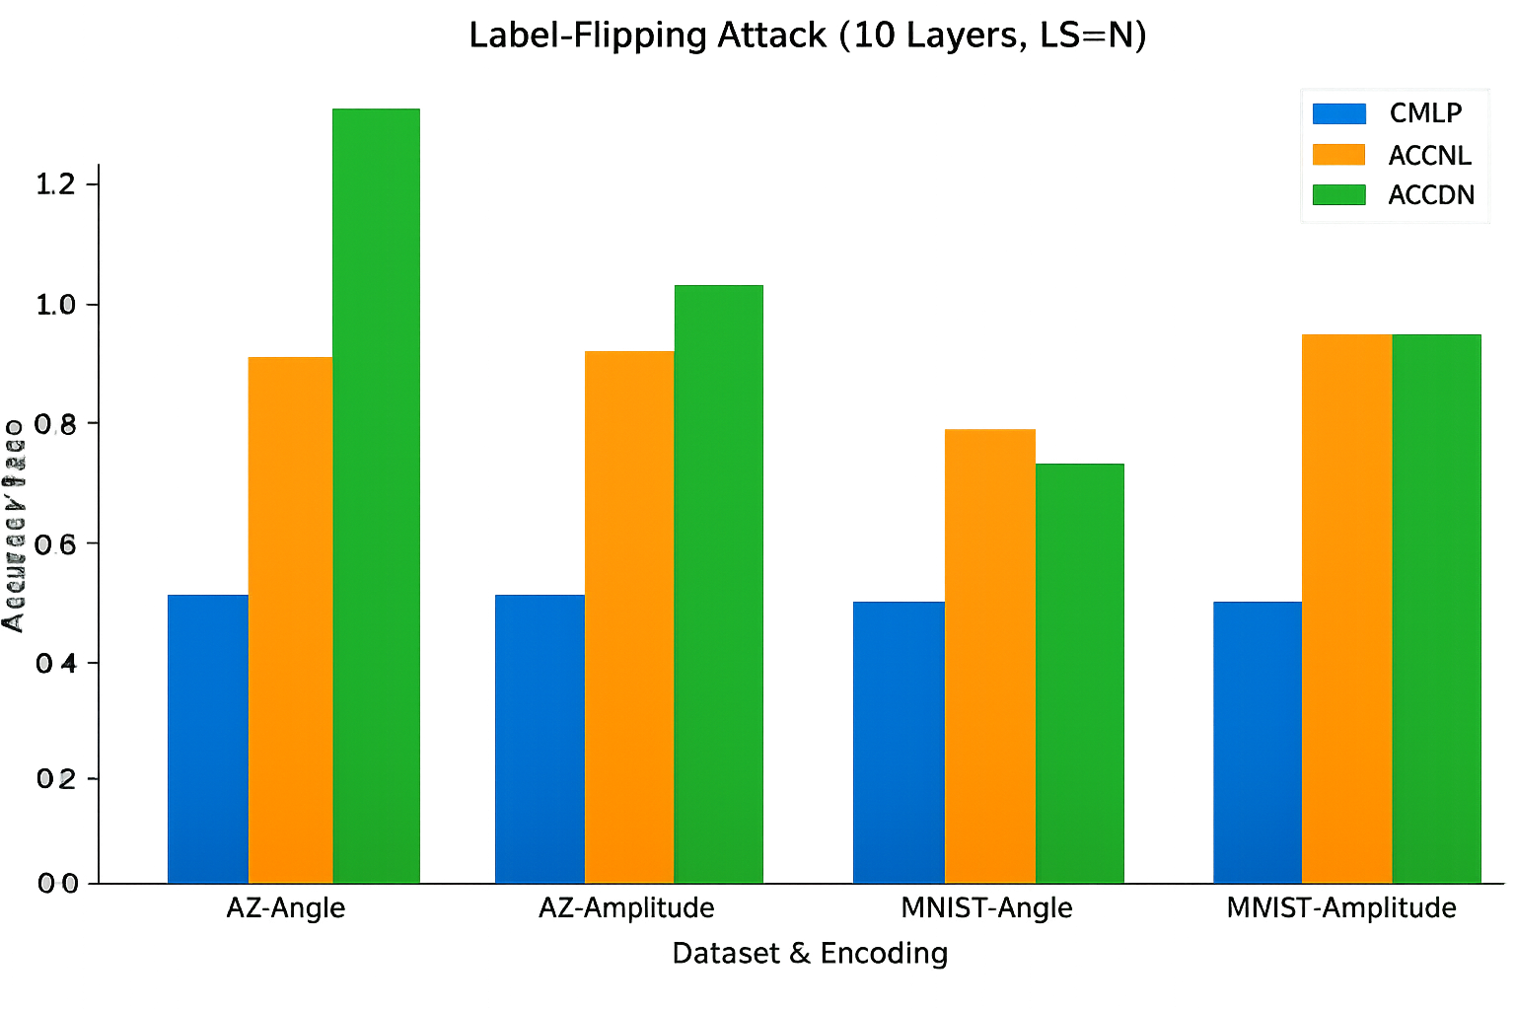
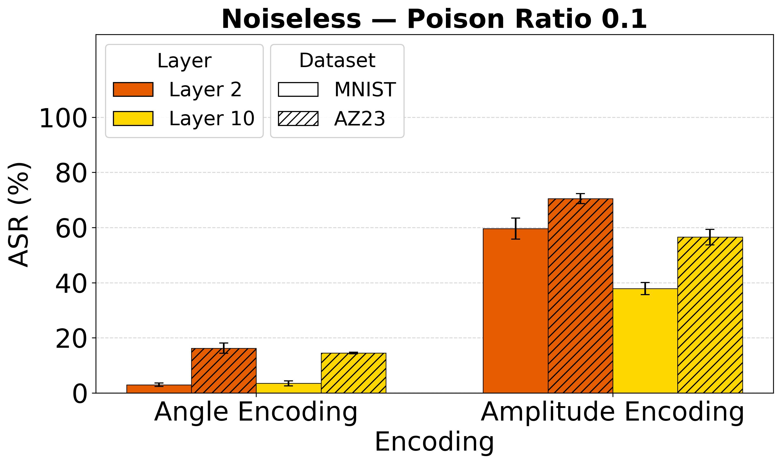
Data-Poisoning Attacks: Label-Flipping and QUID
Quantum Indiscriminate Data Poisoning (QUID) [1]
Label-Flipping
1.2
0.6
…
2.5
…
50% Random Label-Flip
Black-box Attack
z00
z0k
Ф(x)
…
Calculate dσρi
Assign class
with max(dσρ)
…
…
zk0
…
zkk
Classical Input
Data Encoding Circuit
Density Matrix, σ
Accuracy Ratio
Key Insights: QUID
Angle encoding is more resilient at low poison ratio compared to Amplitude encoded models.
Noise acts as a passive defense by disturbing Hilbert space structure.
Key Insights: Label-Flipping Attack
QMLP models exhibit greater robustness than CMLP models, driven partly by lower baseline accuracy.
[1] Kundu, Satwik, and Swaroop Ghosh. "Adversarial data poisoning attack on quantum machine learning in the NISQ era." GLSVLSI 2025.
Notes:
#Slide 6: 1 min 20 sec
------------------------------
We started with a simple black-box attack. Which is 50% random label flipping.
To measure robustness, we used the accuracy ratio metric, which compares the model accuracy under attack with the baseline accuracy.
We observed that QML models appear more robust than classical models against this attack, although this actually come from their already lower baseline accuracy, not from true robustness against the attack.
Next, we evaluated QUID, which is a more aggressive quantum-specific poisoning attack.
Unlike random label flipping, QUID first performs quantum encoding, then manipulates samples in Hilbert space by assigning them to maximally distant class prototypes.
From the results, amplitude-encoded models were more vulnerable, while angle-encoded models showed better resilience, especially at low poison ratios.
Interestingly, under noisy conditions, attack success decreases overall because quantum noise disrupts the Hilbert space structure thus weakens the attack signal.

Slide 7
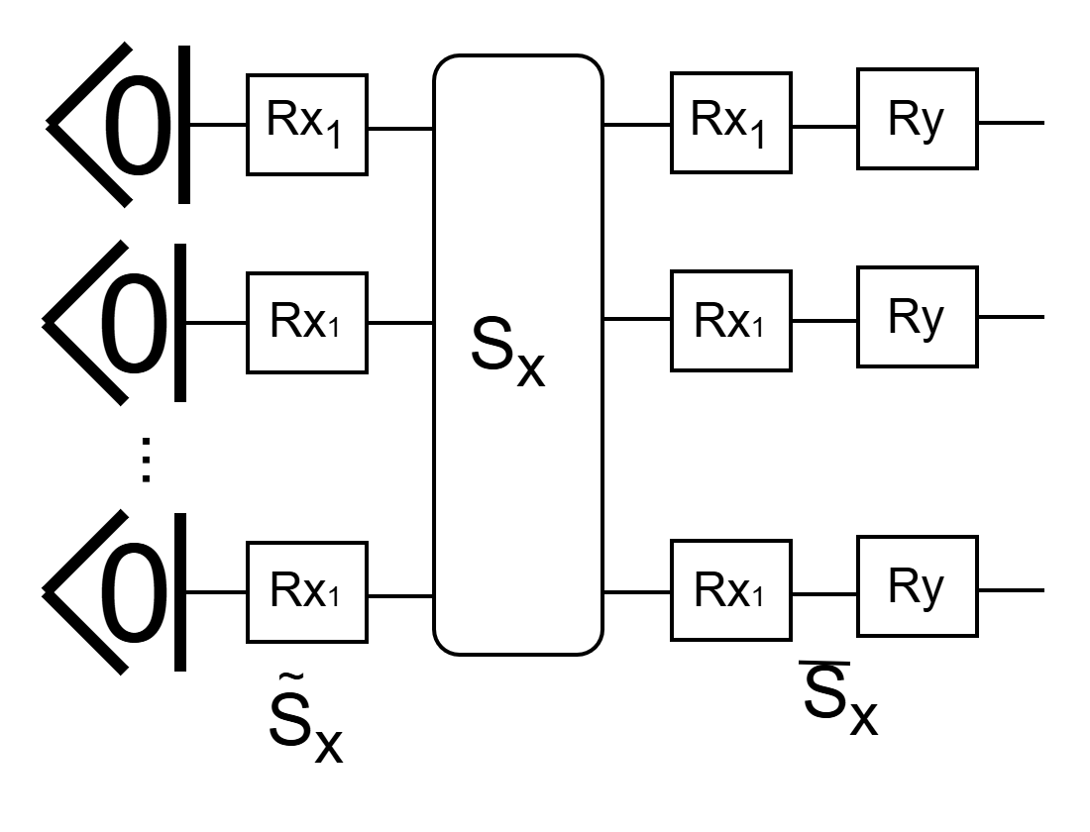
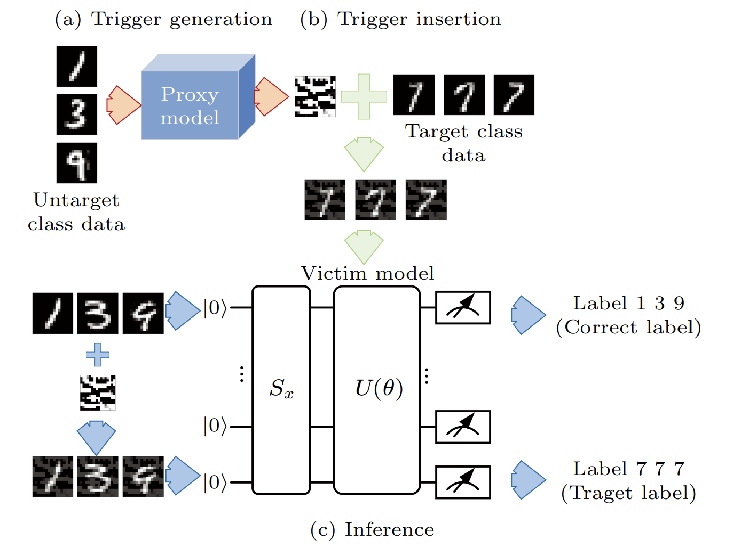
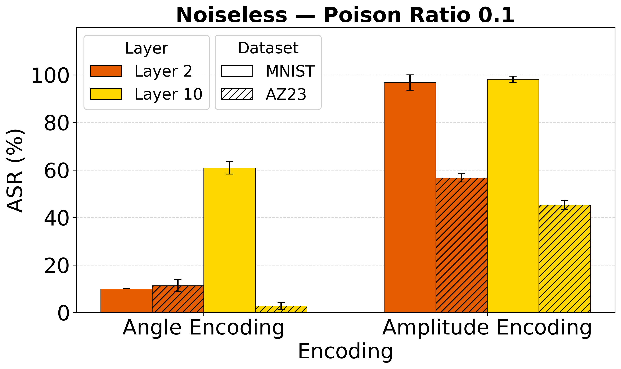
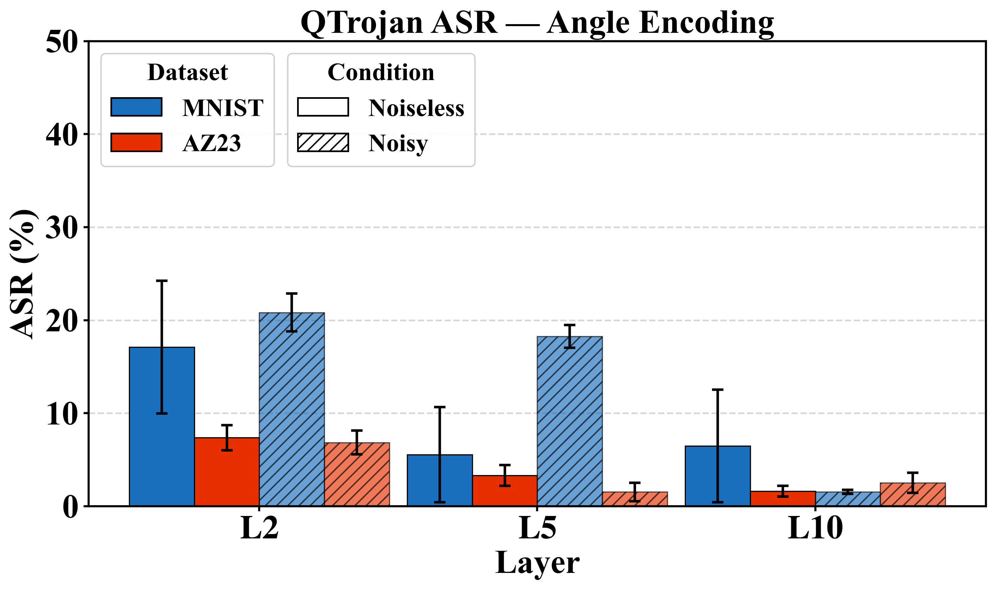
Back-Door Attacks: Qtrojan, Huang et al.
Qtrojan [2]
Huang et al. [3]
Figure taken from [3]
Key Insights: Huang et al.
Highly stealthy
Amplitude encoding is more vulnerable because its single-shot embedding gives the optimized trigger a stable entry point
Trigger is embedded in the trained weights and thus persists as long as the model remains functional.
Key Insights: Qtrojan
QTrojan is a stealthy attack.
ASR is consistently low for multiclass classification
[2] Chu, Cheng, et al. "Qtrojan: A circuit backdoor against quantum neural networks." ICASSP 2023.
[3] Huang, Chen-Yi, and Shi-Bin Zhang. "A backdoor attack against quantum neural networks with limited information." Chinese Physics B 2023.
Notes:
#Slide 7: 1 min
------------------------------
Next, we evaluated two types of backdoor attacks.
The first is Qtrojan, a white-box attack where malicious backdoor gates are inserted before and after the encoding stage.
This attack is specific to angle encoding, cause the backdoor gates use rotation angles to deploy the attack.
The attack is highly stealthy when the backdoor is off.
However, while it works well for binary classification, the attack success rate drops significantly for multiclass settings.
We also evaluated the attack by Huang et al., where attackers generate universal triggers using a proxy model and insert them into poisoned training samples.
Our results show that amplitude-encoded models are much more vulnerable than angle-encoded models.
Unlike the QUID attack, Noise doesn’t provide any defense here because the triggers are embedded in the trained model weights which doesn’t change even if the Hilbert space structure is disturbed.

Slide 8




Key Takeaways
In noiseless condition, Deep Amplitude Encoded models perform the best
Angle Encoded models are more robust against most attack cases.
Noise acts as a passive natural defense against some attacks
Shallow Angle Encoded Circuits are the most optimal choice for NISQ devices
Notes:
#Slide 8: 50 sec
------------------------------
So, our final takeaways are the following.
First, amplitude encoding with deeper circuits provides the best performance under ideal noiseless conditions.
However, angle-encoded models are generally more robust against most types of adversarial attacks.
We also observed that quantum noise can sometimes act as a passive defense mechanism by weakening certain attacks.
And finally, for current NISQ-era quantum devices, shallow angle-encoded models appear to be the most optimal and secure choice.

Slide 9
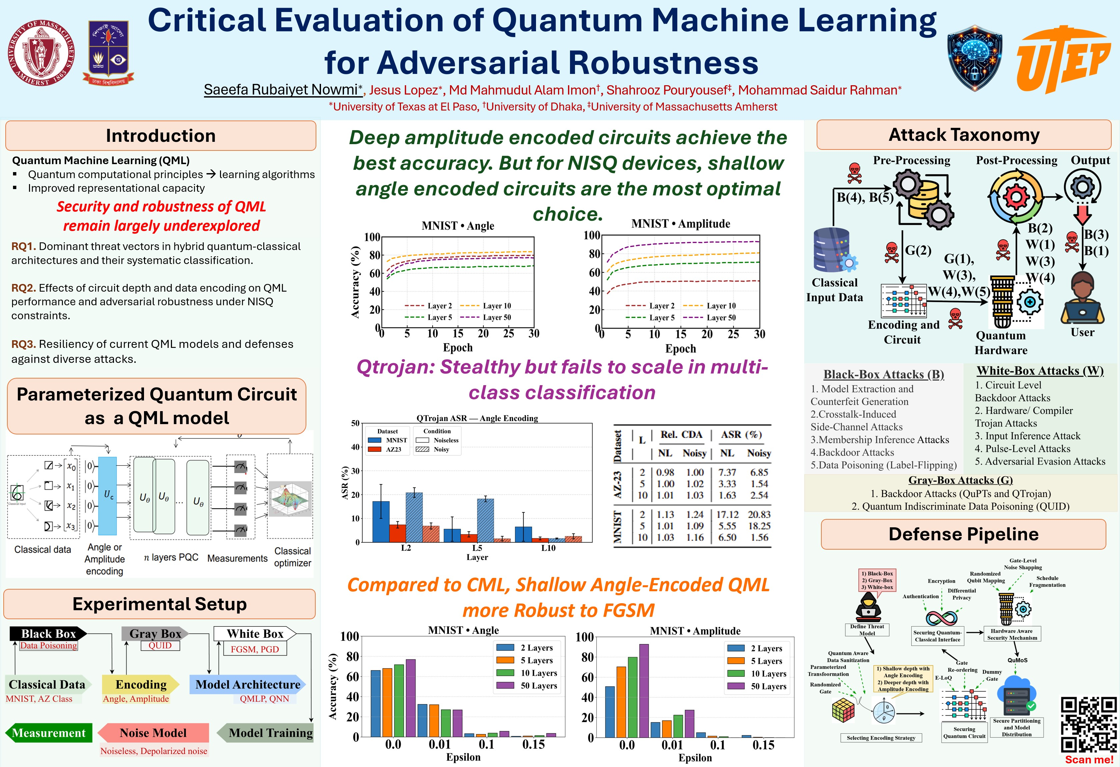
Thank you!!
Visit our Poster
Project webpage
Notes:
#Slide 10: 30 sec
------------------------------
We have several additional experiments and analyses that we could not include today due to time limitations.
Based on our taxonomy and experimental findings, we also propose guidelines for designing secure and robust QML systems.
We discuss these in much more detail in our poster and project webpage, so please feel free to visit them.
And thank you very much for your time.

Slide 10
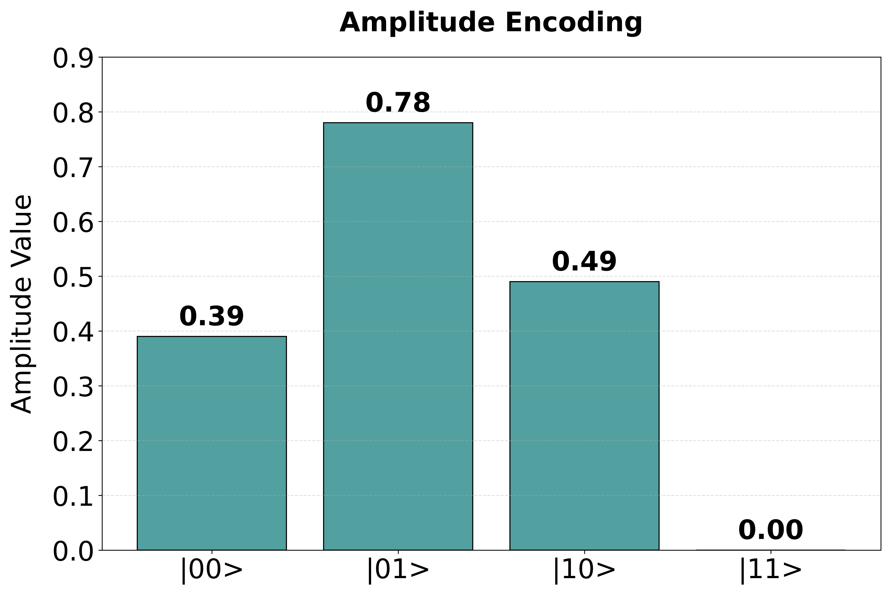


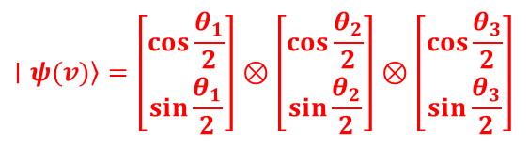


Hybrid Quantum Classical Machine Learning Model
Qubits
Classical Optimizer
Classical Data
Encoding
U
Measurements
Parameterized Quantum
Circuit (PQC)
Amplitude Encoding
Angle Encoding
Q0: Ry(0.5π) |0>
Q1: Ry(0.625 π) |0>
Q2: Ry(π) |0>
Normalize [ norm 1]
||V||=$\sqrt{4^{2}+8^{2}+5^{2}+0^{2}}$= $\sqrt{105}$
Normalize [0 – π]
y
π
θ
α
α
∣ψ⟩=cos $\frac{θ}{2}$​∣0⟩+sin$\frac{θ}{2}$​∣1⟩
V = [4,8,5]
0.625π
x
α
α
0.5π
2^{n} Dimensions
z
$$\left.∣ψ(v)\right\rangle =\left[\begin{matrix}\cos{\frac{θ_{1}}{2}} \\ \sin{\frac{θ_{1}}{2}}\end{matrix}\right]⊗\left[\begin{matrix}\cos{\frac{θ_{2}}{2}} \\ \sin{\frac{θ_{2}}{2}}\end{matrix}\right]⊗\left[\begin{matrix}\cos{\frac{θ_{3}}{2}} \\ \sin{\frac{θ_{3}}{2}}\end{matrix}\right]$$
Vpad= [4,8,5,0]
∣ψ(v)⟩=$\frac{1}{\sqrt{105}}$​(4∣00⟩+5∣01⟩+8∣10⟩+0∣11⟩)
Notes:
Before discussing security, let me briefly explain how a hybrid QML model works.
Classical data first needs to be encoded into quantum states. Two common encoding methods are shown here:
Angle encoding, where features are mapped to rotation angles.
Amplitude encoding, where the normalized feature vector is embedded into quantum amplitudes.
The encoded quantum state is processed through a parameterized quantum circuit, or PQC, and then measurements are sent back to a classical optimizer for training.
A key point is that the encoding strategy fundamentally changes both the model capability and its security properties. That becomes one of the central findings of our work

Slide 11
Why Quantum Machine Learning (QML)
Intuition:
Quantum systems naturally live in exponentially large vector spaces named Hilbert space, and maybe that allows them to represent complicated features more efficiently than classical models.
A single qubit:
|ψ⟩= α|0⟩ + β|1⟩
lives in a 2D complex vector space.
2 qubits:
|ψ⟩= α00|00⟩+ α01|01⟩+ α10|10⟩+ α11|11⟩
This is 4D.
n qubits:
Dimension becomes:
2^n
So:
10 qubits → 1024 dimensions
50 qubits → ~10^15 dimensions
300 qubits → more than atoms in universe
The hope is:
Some structures may become simple in Hilbert space.
Entanglement increases expressivity of QML models
Problem is:
Practical QML is currently limited to 8-20 qubits with Noisy Intermediate-Scale Quantum (NISQ) era quantum devices.
Notes:
#Slide extra----------- 3 mins
----------On Blank Slide--------
When we say QML, the first question that naturally comes is – Why?
Why do we need QML? What are the advantages of QML over CML? And most importantly, if QML has advantages over CML, why is it not out-performing CML yet?
----------Intuition-------------
The first thing is, quantum systems naturally live in a very high dimensional vector space called Hilbert Space.
--------Qubits----------------
Suppose, for one qubit, there are 2 dimensions.
For 2 qubits, there are 4 dimensions.
And for 300 qubits, the number of dimensions becomes larger than the number of atoms in the whole universe.
---------Hope----------
So, the hope is, when we embed classical data into quantum space, like feature mapping, difficult classical problems become simpler.
And, the entanglement property helps represent the correlation between features in a much better way that is extremely expensive for the classical systems to reproduce.
-----------Problem---------
But, the problem is, right now, QML is only limited to 8 to 20 qubits for NISQ era for practical reasons. Thus, when researchers build QML models, in most cases, they use huge dimensionality reduction which results in significant information loss. That is one of the major reasons why QML models do not yet perform as well as classical machine learning (CML) models yet.

Slide 12
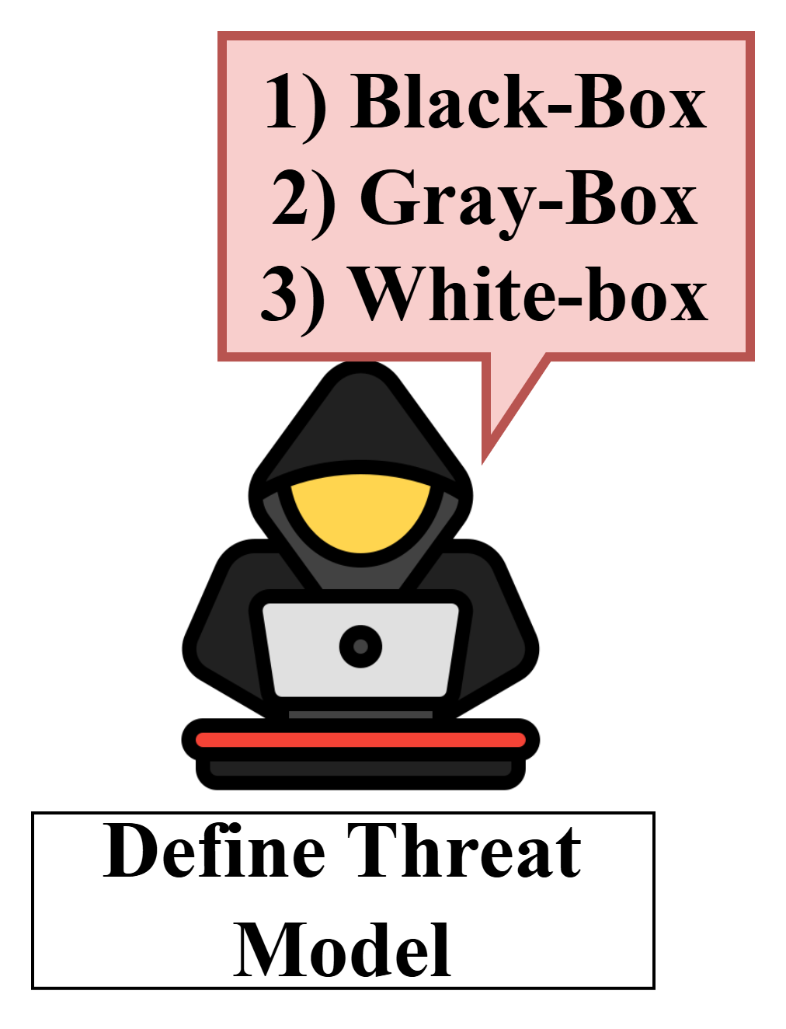
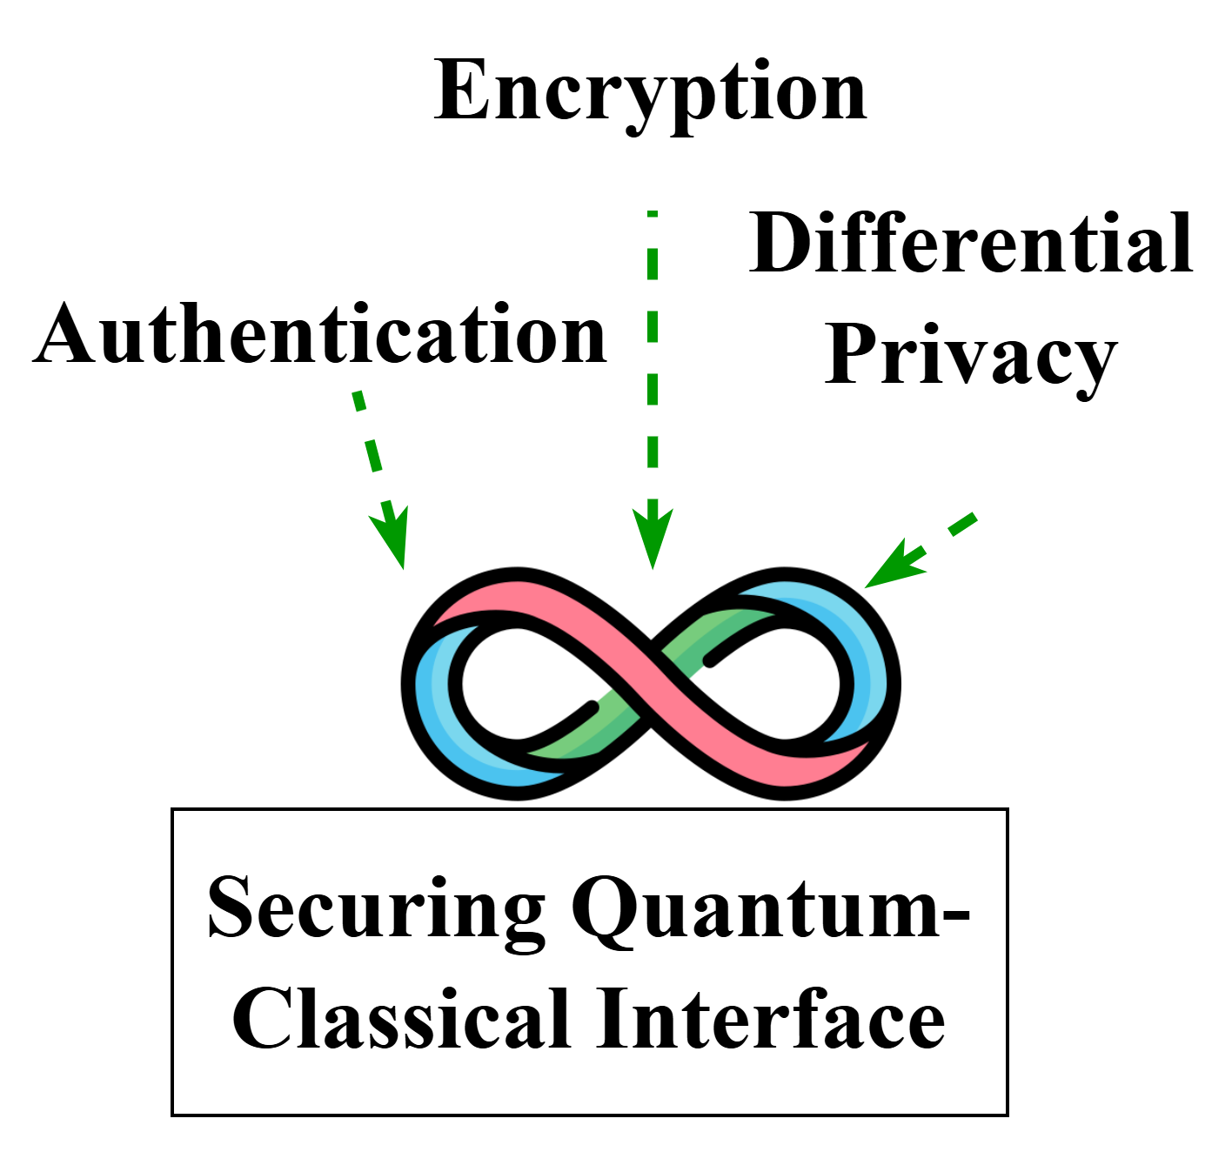
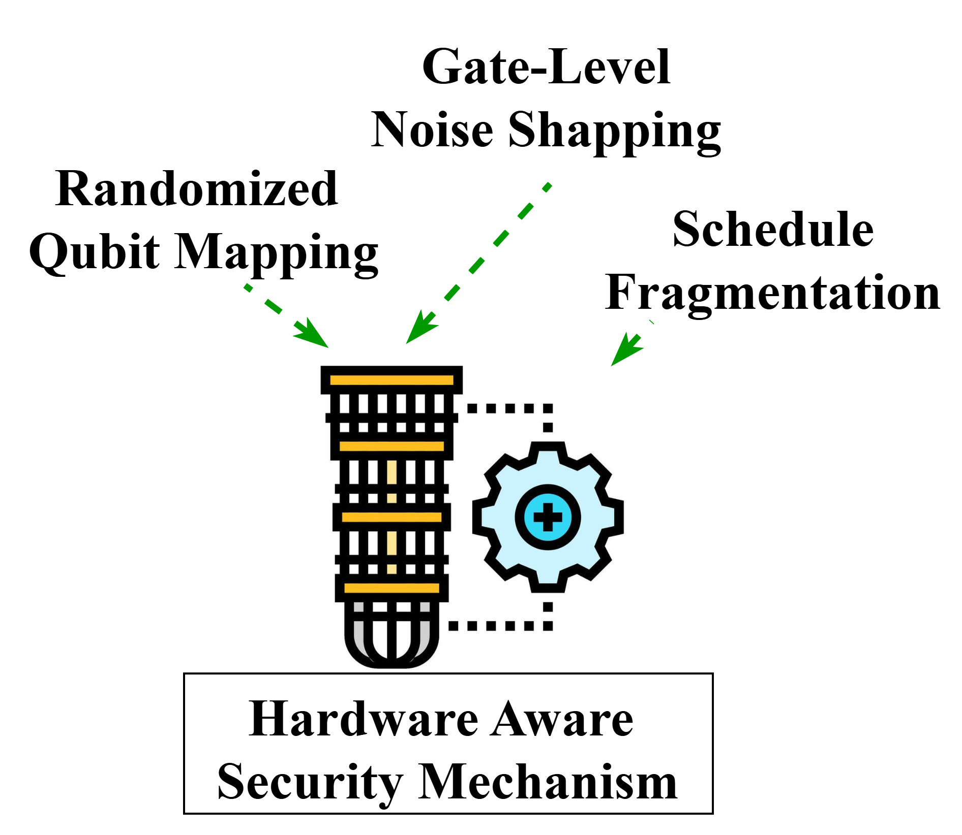
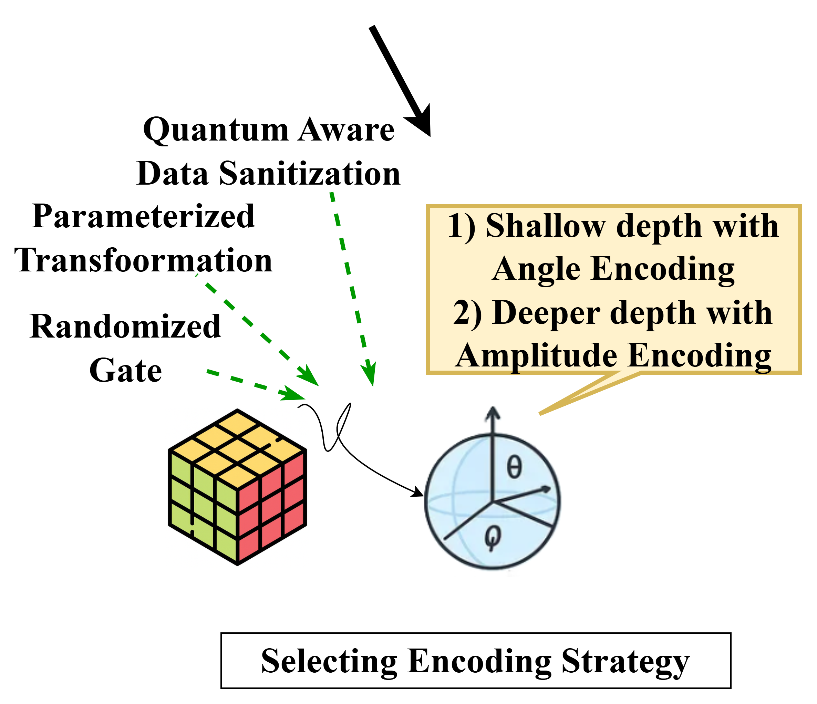
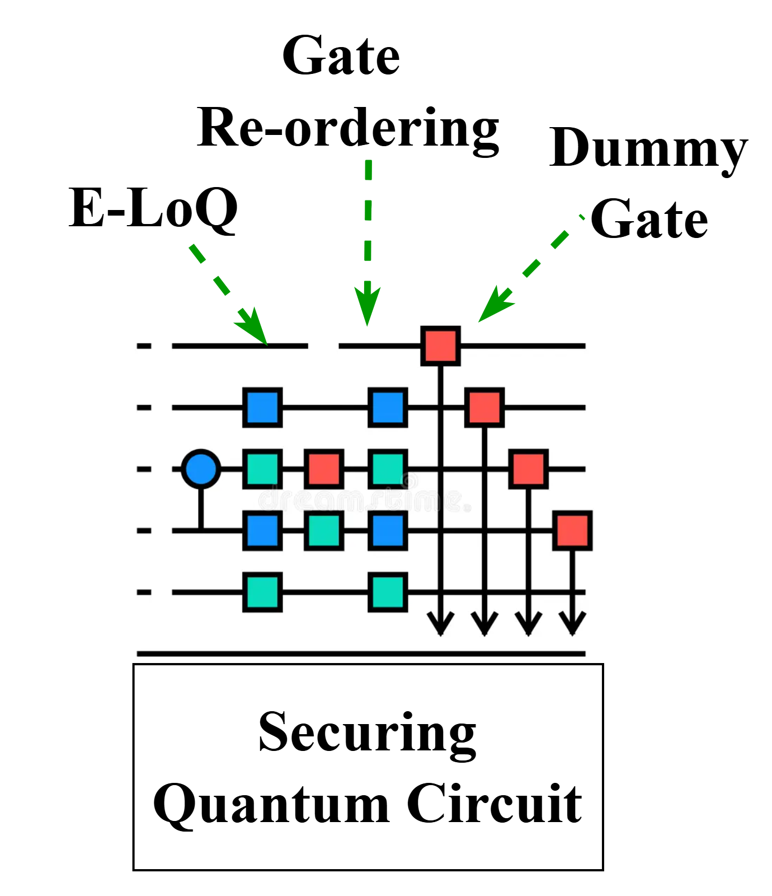
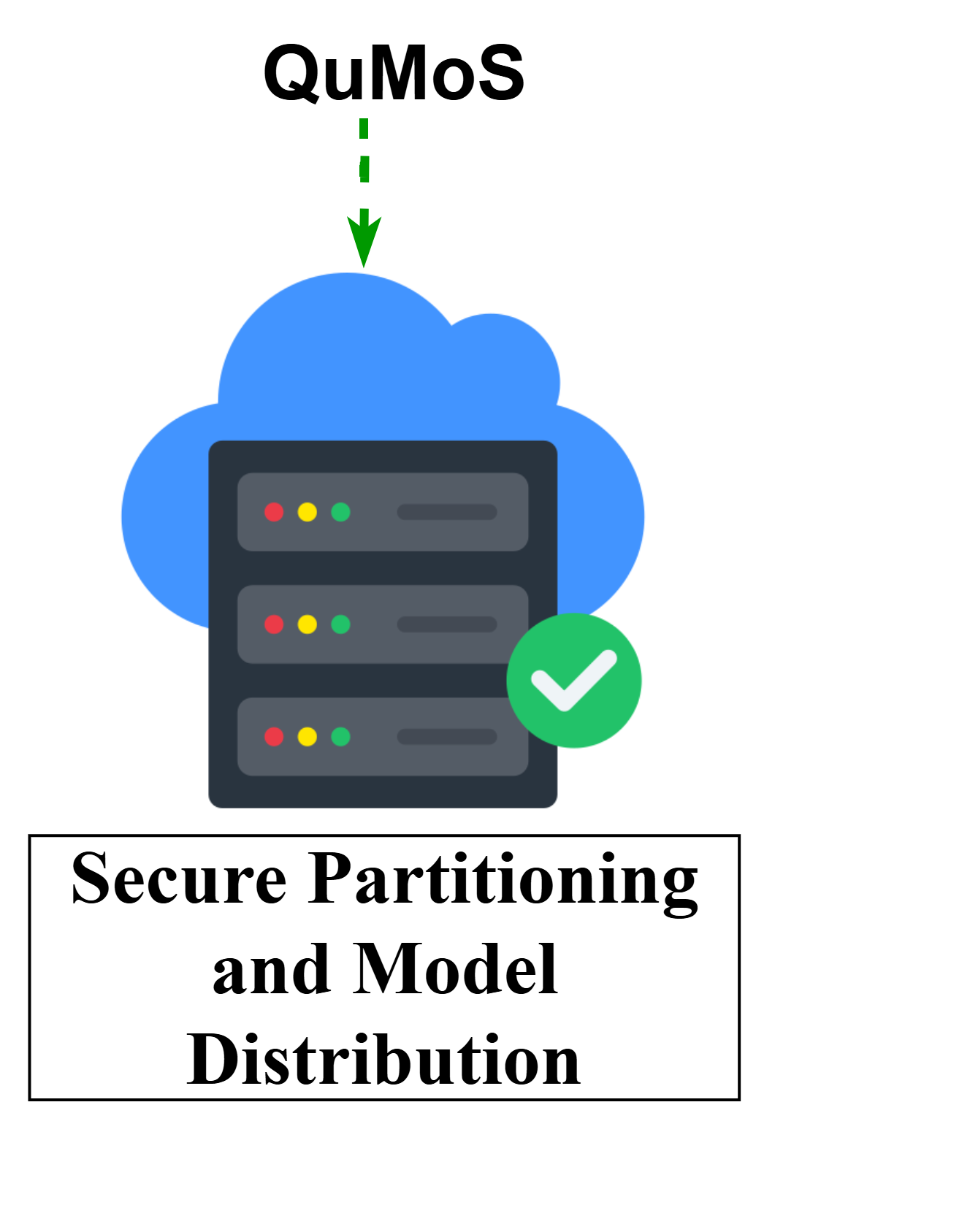
Secure and Robust QML Pipeline Design
Notes:
Hybrid Attack Surface: QML inherits legacy vulnerabilities from Classical ML while introducing novel, poorly understood quantum-specific attack surfaces.
Cloud service: At todays world, we don’t have personal quantum computers. So, people use the cloud services for accessing quantum hardware remotely from different vendors like IBM quantum, Microsoft azure etc. which creates a huge additional attack surface as to use these services, users need to deploy there models and data to the cloud servers which can be an access point for the attackers. Even without that, as NISQ devices are not fault-t0lerant and multi-tenant, an attacker can deploy side-channel attacks very easily if they can just ensure to get control over the neighbouring qubits.
Encoding Dictates Vulnerability: Fundemental choice of data encoding dictates both the ceiling of computational performance and the adversarial fragility.
QML is a pretty new field which is still emerging. So, there are not many established norms yet. Most of the theorical studies and formal analysis type of studies come from physics community which don’t always align with the computer science community’s practical needs.
And within the compter science community, researchers use various encodings and circuit arhitectures mostly randomly or the deciding factor becomes the computational cost or resource constraint. So, we propose a systematic analysis for existing studies within a generalized structure where we can better understand the attack surfaces, we can better understand the benefits and limitations of different encoding schemes and thus can deploy better security measures against attacks.

